Slide 1
Autonomous Driving
By: Hongman Cho, Murali Komaravolu & Vibhavi Peiris

Slide 2
Intro
Part 1: Finding the road
Part 2: Finding cars and their viewpoints

Slide 3
Intro
Goal
Identify the road and cars in an image
Motivation
Save lives, make life easier
We get to use what we learned in a real life application
More and more cars have this technology

Slide 4
Intro
We all contributed equally to all parts of this challenging project, and there isn’t an easy to say who did what part. However below are the rough divisions as requested by the TA.
Murali: Found the disparity, depth, fit the plane for the road & detected cars. Part 1b,c,f & 2b
Hongman: trained viewpoint classifiers, predicted viewpoint & the 3d bounding box. Part 2 c,d,e
Vibhavi: trained road classifiers, predicted road & plotted 3d point cloud. Part 1d,e,g

Slide 5
Part 1 – The Road

Slide 6
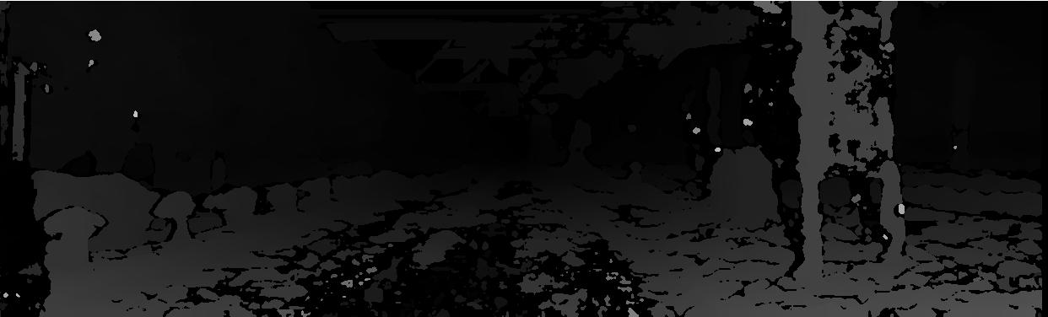
Disparity
Part 1b
To find the disparity map, we took the left and right images and used the build-in disparity method to return the disparity values and save them.
With the Disparity Range of [0 16*15] and a patch size of 15

Slide 7
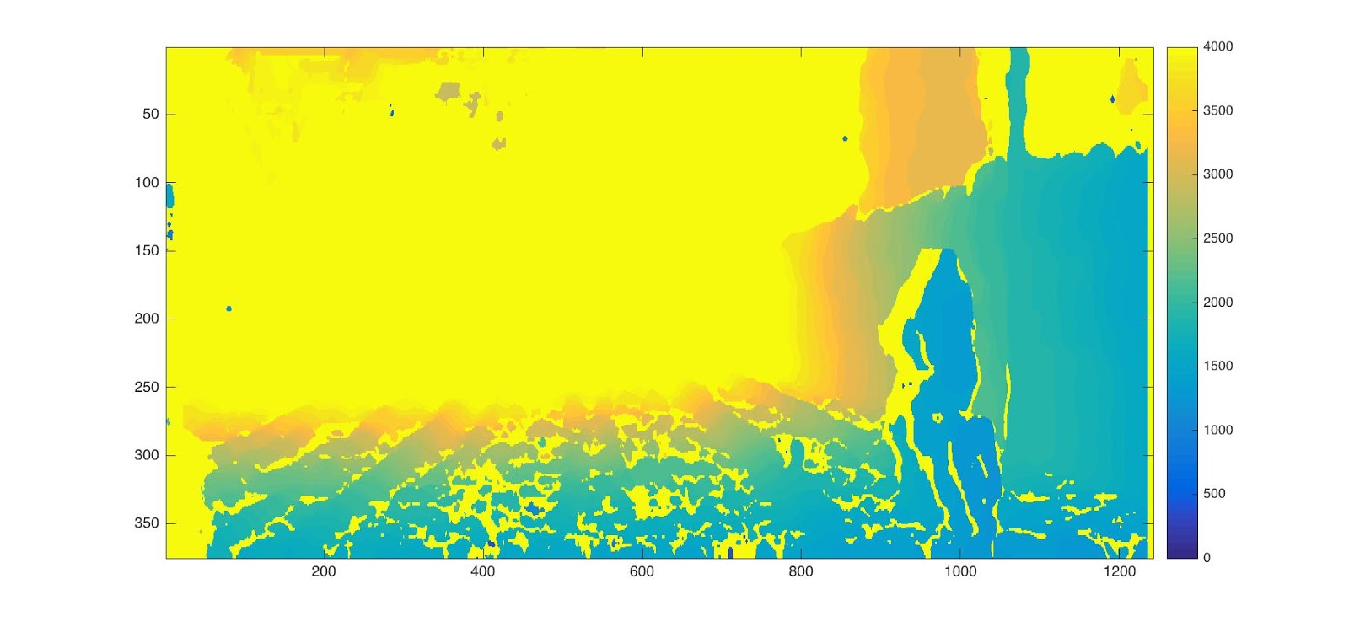
Depth
Part 1c
Now that we had the disparity map and the calibration values, we could find the depth of the image using:
depth = calib.f * calib.baseline / disparity;

Slide 8
Training
Part 1d
First Attempt:
We computed features for every pixel
We also used HOG as a feature
This resulted in really bad and random predictions

Slide 9
Training
Part 1d
Second Attempt:
We decided to get features for every super pixel.
Around 500 superpixels in an image
We created labels for each super pixel using ground truth image
Then we got the following features for each image.
- Color (R, G, B)
- Histogram of Hues
-3d Y coordinate
-Gradients in X and Y direction
We choose a 250 random superpixels from each image.
Finally we ran svmtrain on all the choosen superpixels

Slide 10


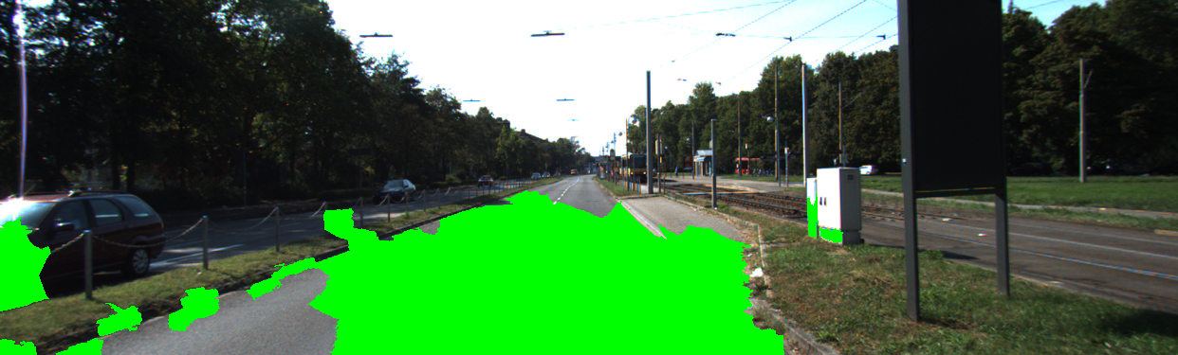
Predicting
Part 1e
We computed the feature vector for each test image
Ran the built-in predict function on those features with our model
Then created a ground truth and color image of the predictions

Slide 11
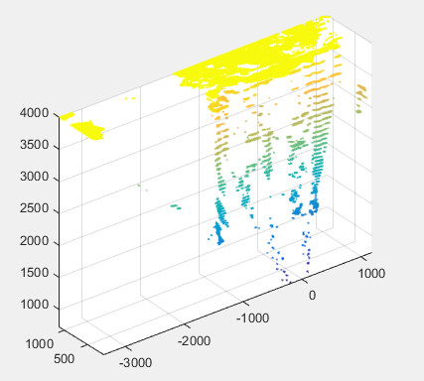
Fit Plane
Part 1f
We used select() to return a cropped point cloud given the predicted image and the original point cloud.

Slide 12
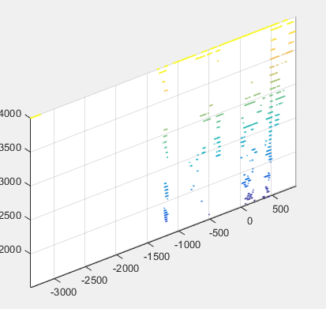
Fit Plane
Part 1f
Then, we used pcfitplane to return a plane model that goes through the point cloud and is robust to outliers.
It returns a set of inliers outliers, and the plane road.

Slide 13
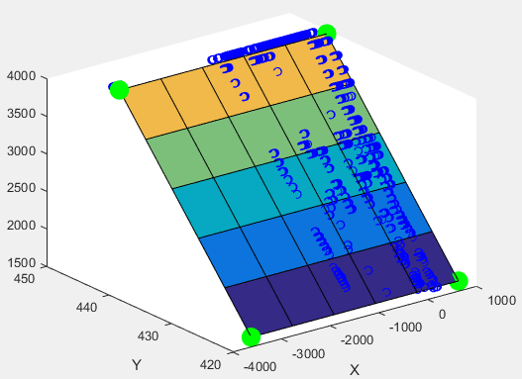
Road point on the ground plane
Part 1e
After getting a set of inliers, we fit a mesh grid through the points

Slide 14
Part 2 – The Cars

Slide 15
Main Challenges

Slide 16
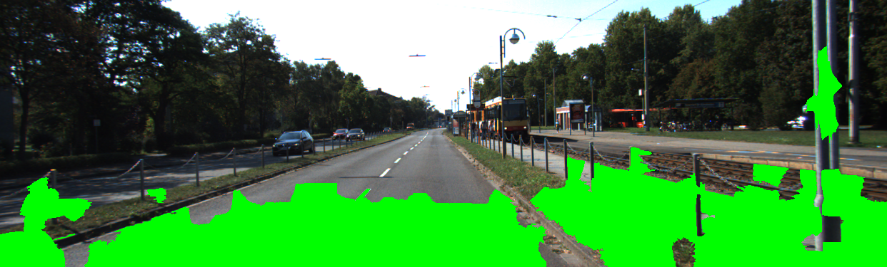
Main Challenges
Deciding what features to use for road detection
Initially used HOG, and got features for every pixel
In the end we use color, hue 3dY and gradient
Also we got features for every super pixel

Slide 17
Results

Slide 18
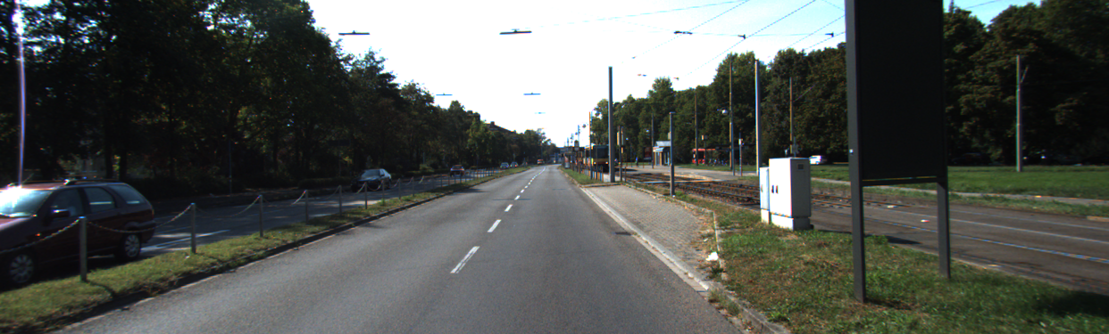
Results: Predicted GT Road
Trained 94 images
Each took 15 to 30 seconds to compute features
Total of 48 minutes to train all images

Slide 19
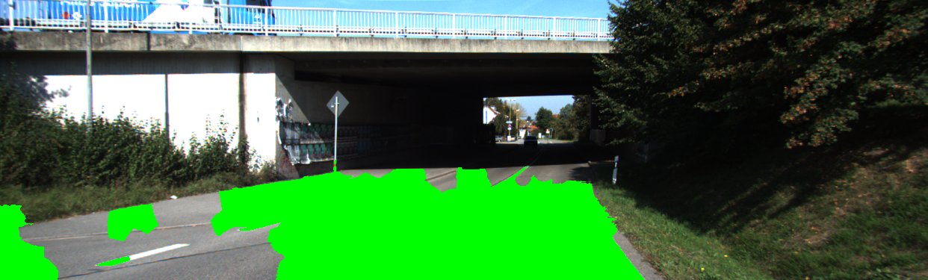
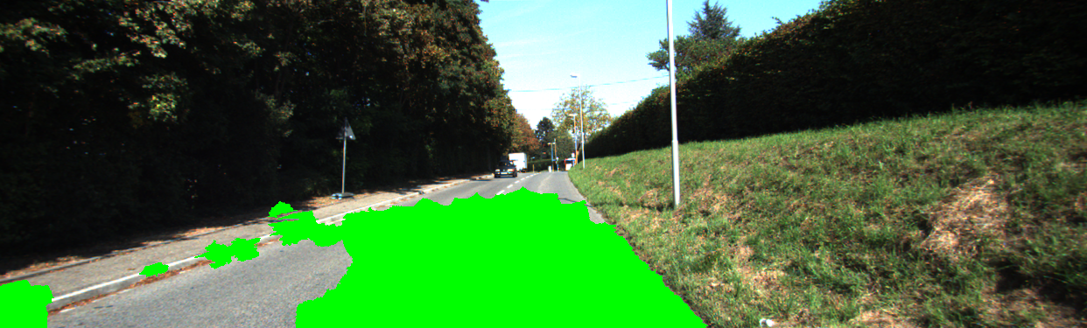
Good Predictions
Very few non-road object are detected as road
Detects most of the road as 'road'

Slide 20

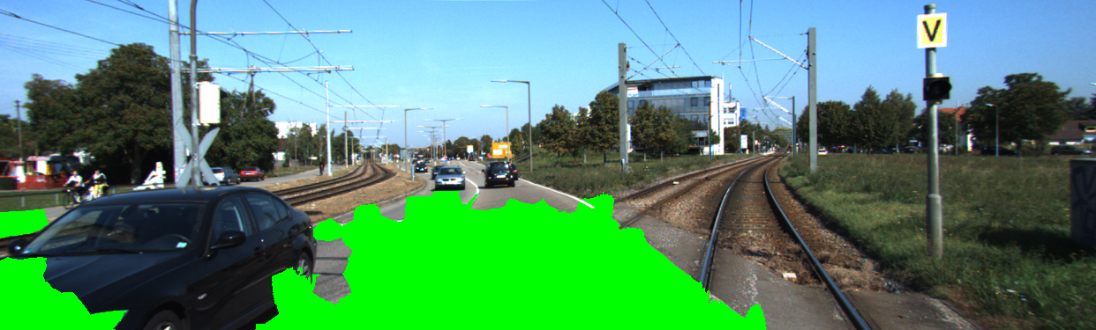
Bad Predictions
There are 2 possible solutions to these issues:
One is to further tune the parameters like what features we use and how many random superpixels we choose. For example, we noticed that using histogram of hue values (as suggested by our professor), as one of our features greatly improved the results.
The other option is to use ransac to only take predicted superpixels that lie on the ground plane.

